Slide 1
Sensitive Data Labeling

Slide 2

Data sensitivity labels
Confidential
Must be approved to view the data
Could cause harm to organization
Private
Restricted access
Few people should have access
Public
No restrictions when viewing data

Slide 3
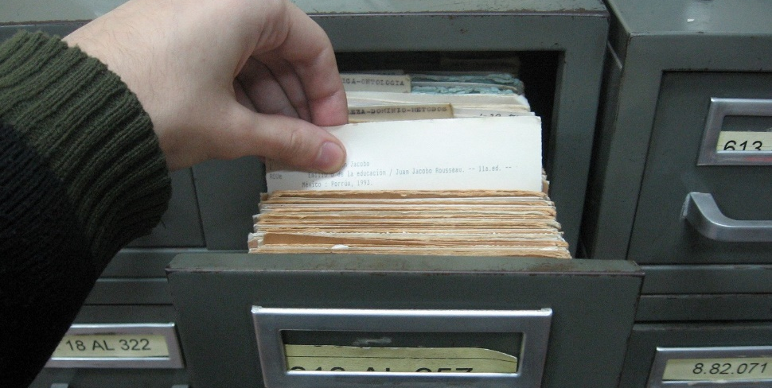
Data sensitivity labels
Proprietary
Restricted by company because of potential competitor use
PII (Personally Identifiable Information)
Data specific to the identity of a person
PHI (Protected Health Information)
Health records
Mandated by HIPAA

